Slide 1



Sustainable Supply Chain - PowerBI

Slide 2

Learning Objectives
The goal of using Power BI for a sustainable supply chain is to enable data-driven decision-making and improve sustainability performance by visualizing and analyzing data related to environmental, social, and economic impacts across the entire supply chain.
GOAL
Source :
www.freepik.com/

Slide 3
Tools and Technology used
Patform:- Microsoft Power BI Desktop is
Bar Chart:
The bar chart is displaying the "Sum of Production Volumes." It's likely organized by different products or production lines, with the height of each bar representing the total volume produced.
Line Chart:
The line chart is showing "Production Volumes by Lead Time." This tells you how production volume changes over time. You can see if there are trends or fluctuations in production.
Map:
The map with blue dots is showing "Sum of Revenue Generated by Location." The size of the dots might indicate the amount of revenue generated at each location.
Table:
The table is showing "Sum of Shipping Costs by Shipping Carriers." This gives you a breakdown of how much it costs to ship goods using different carriers.
For developing the Sustainable Supply Chain Performanc- PowerBI many graphs are used.

Slide 4
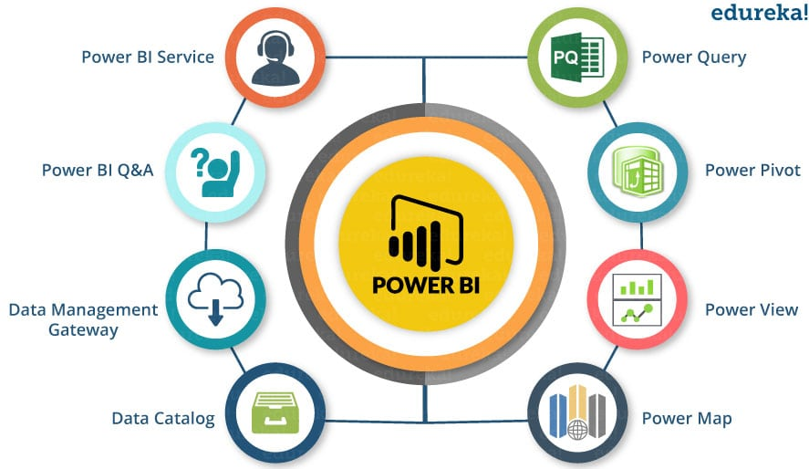
Methodology
Data Collection and Integration:
Gather data from suppliers, logistics, and sustainability reports.
Clean and integrate data into Power BI for a unified view
Key Metrics and Modeling:
Define and calculate sustainability metrics (e.g., carbon emissions, energy use).
Build data models with relationships between suppliers, products, and environmental data
Interactive Dashboards:
Create dashboards to visualize sustainability KPIs.
Use filters and drill-downs for detailed analysis.
Analysis and Reporting:
Analyze trends and supplier performance.
Generate automated reports for stakeholders.
Continuous Improvement:
Regularly update data and dashboards.

Slide 5
Problem Statement:
Companies often struggle to monitor and analyze the sustainability performance of their supply chains due to fragmented data sources and lack of comprehensive visualizations.
The current systems may not provide real-time insights into key sustainability metrics, making it difficult for businesses to make informed decisions and improve their environmental and social impact.
There is a need to develop a Power BI dashboard that integrates data from supply chain operations, providing detailed visualizations and analytics to track sustainability metrics such as carbon footprint, energy consumption, waste management, and supplier compliance.

Slide 6
Solution:
Track Key Metrics:
Use Power BI to monitor sustainability KPIs like carbon emissions, energy use, waste, and water consumption in real time.
Identify Inefficiencies:
Analyze data to find areas where resources are wasted or processes can be made greener.
Set and Track Goals:
Use Power BI to set sustainability targets (e.g., reducing emissions) and track progress visually over time.
Engage Suppliers:
Share dashboards with suppliers to ensure they meet sustainability standards and improve collaboration.
Set and Track Goals:
Use Power BI to set sustainability targets (e.g., reducing emissions) and track progress visually over time.

Slide 7
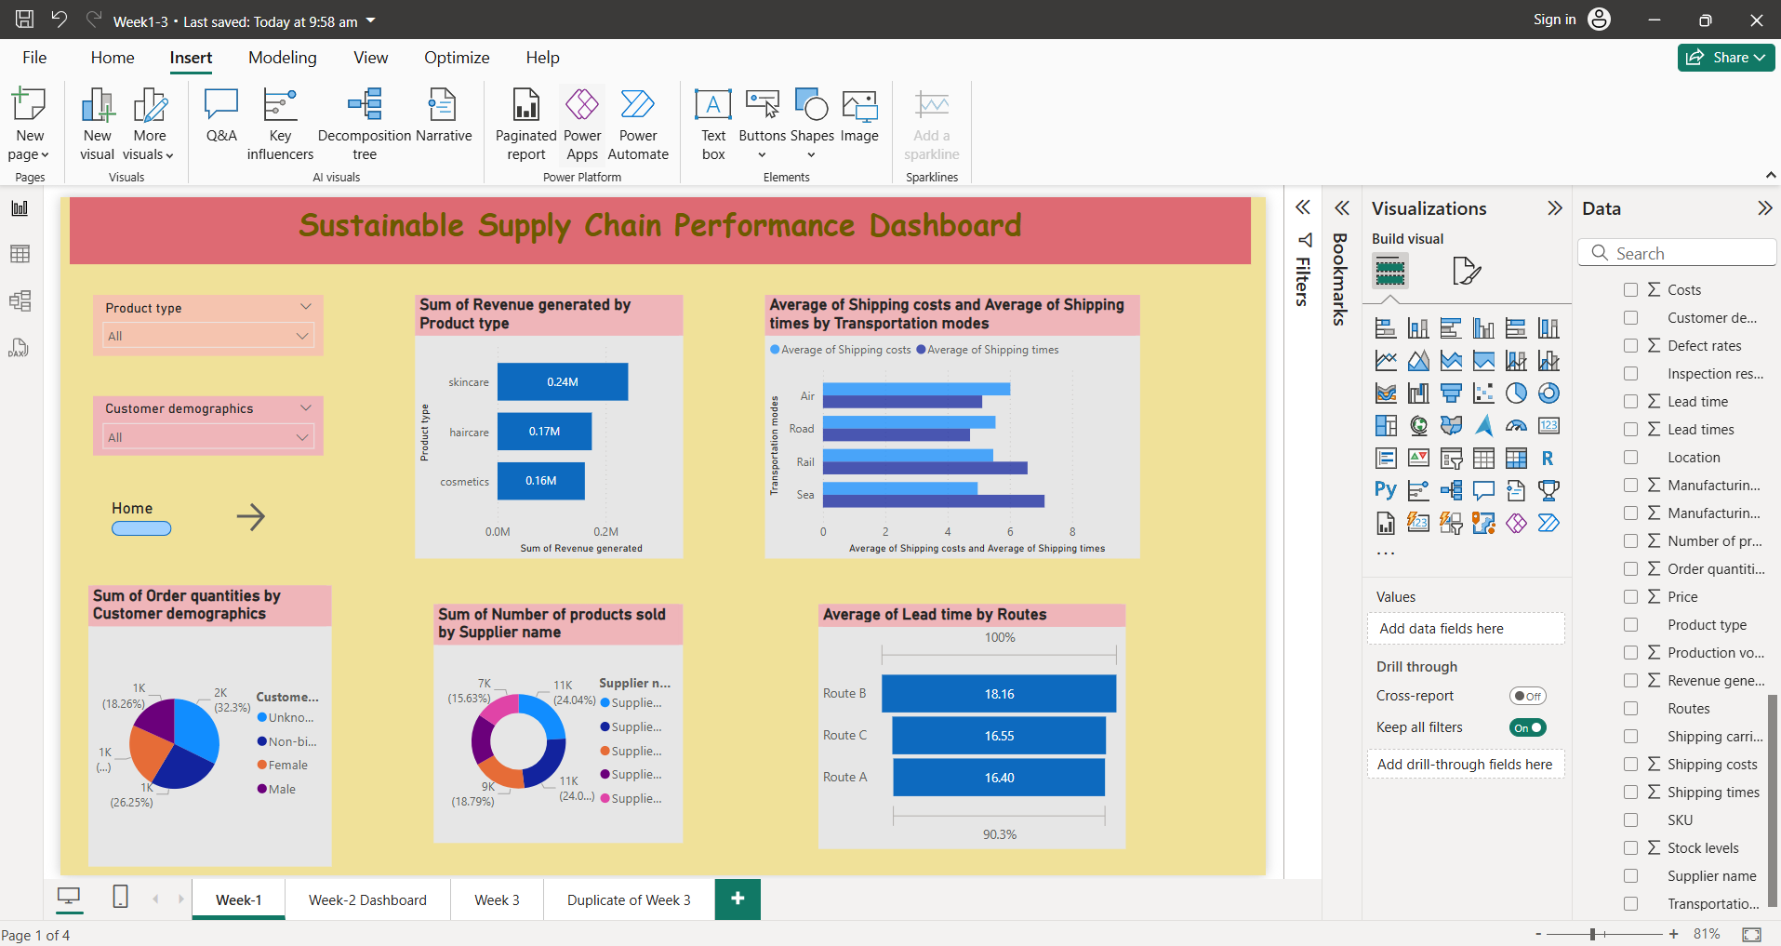
Screenshot of Output:

Slide 8
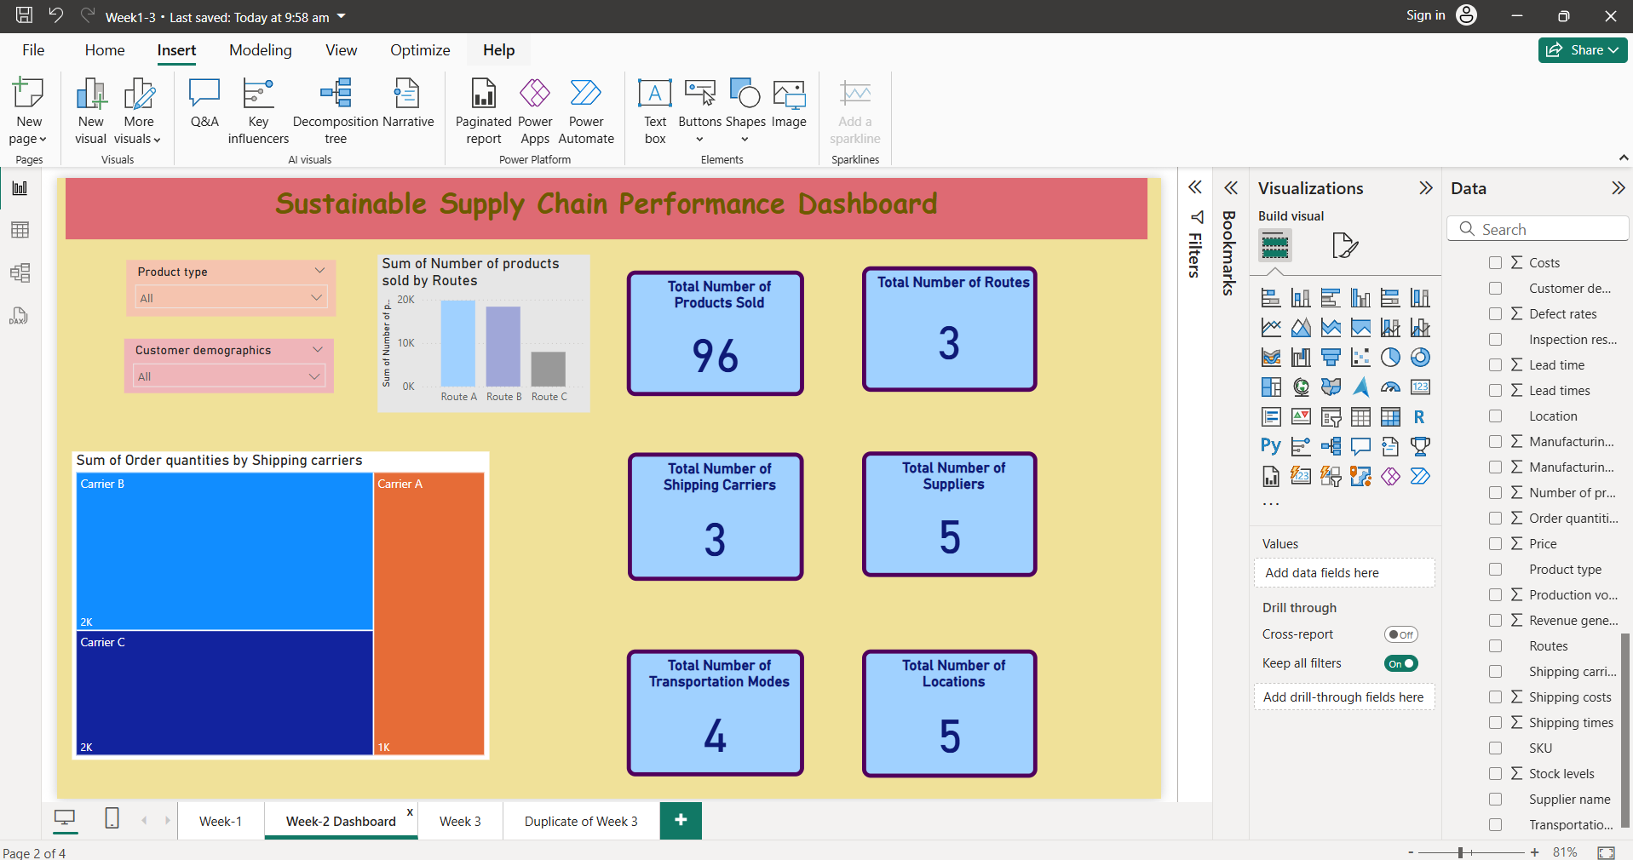

Slide 9
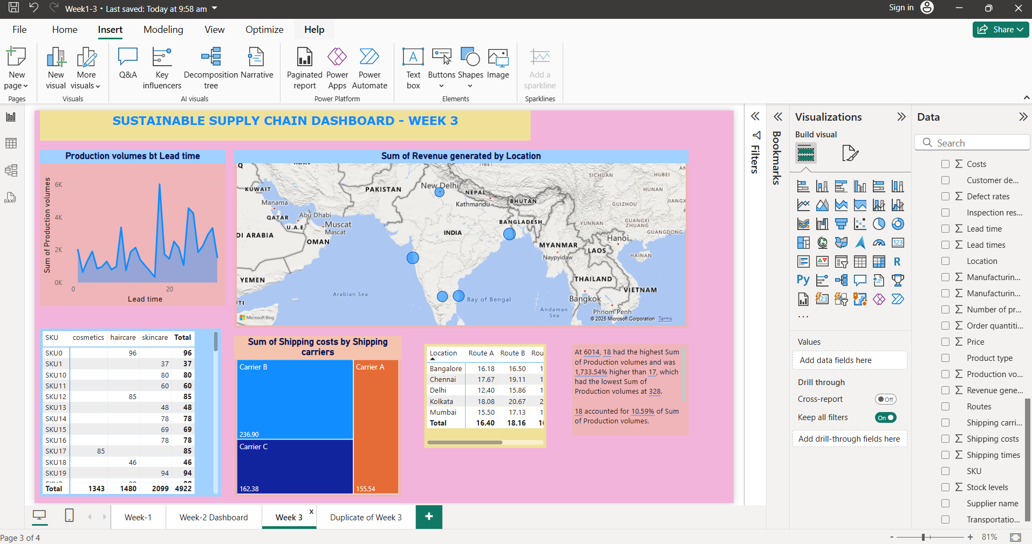

Slide 10
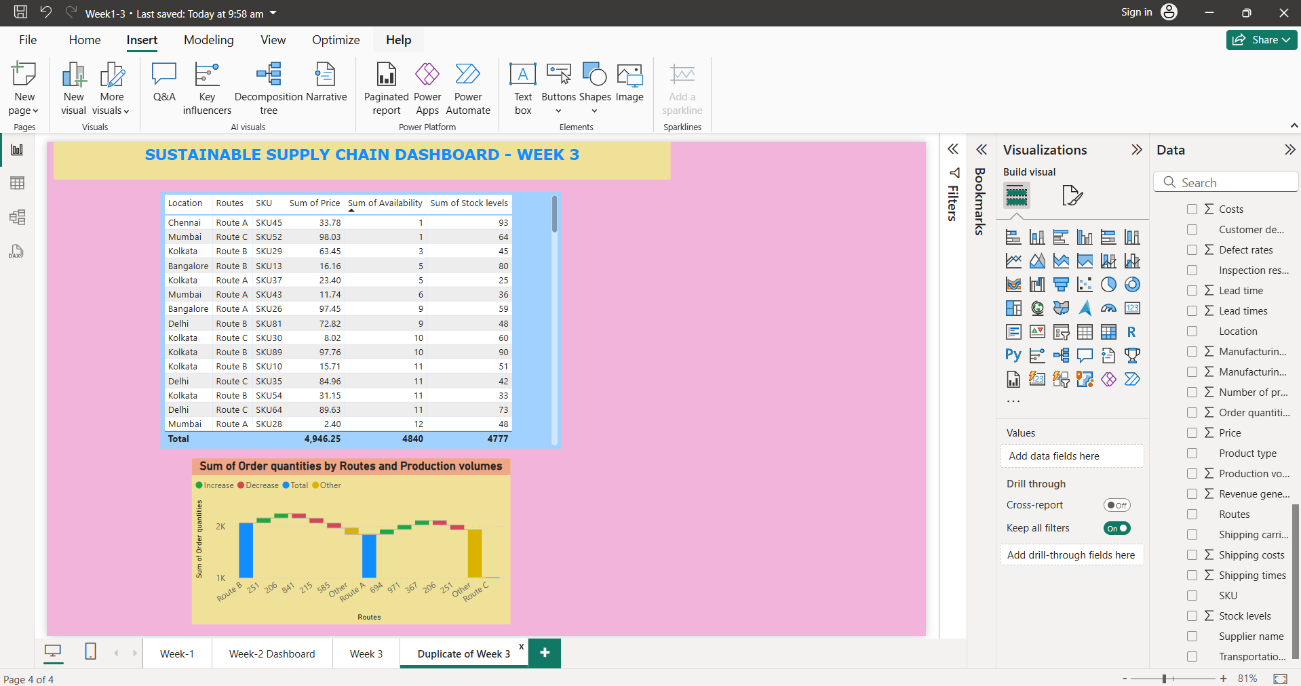

Slide 11

Conclusion:
The development and implementation of the Sustainability Supply Chain Performance Dashboard in Power BI have proven to be a transformative step towards achieving more sustainable and efficient supply chain operations.
By leveraging Power BI's robust data visualization and analysis capabilities, the dashboard has provided critical insights into various aspects of sustainability, enabling data-driven decision-making and fostering a culture of continuous improvement
GitHub Repository Link:
hit

Slide 12
Thank You!

